Slide 1
MISP-Malware Information Sharing Project
Sarah Noles, Brian Mellon, Greg Hoff, and Carl Deike

Slide 2
What is MISP
An open source threat intelligence platform, using open standards for threat sharing.
Mostly written in PHP

Slide 3
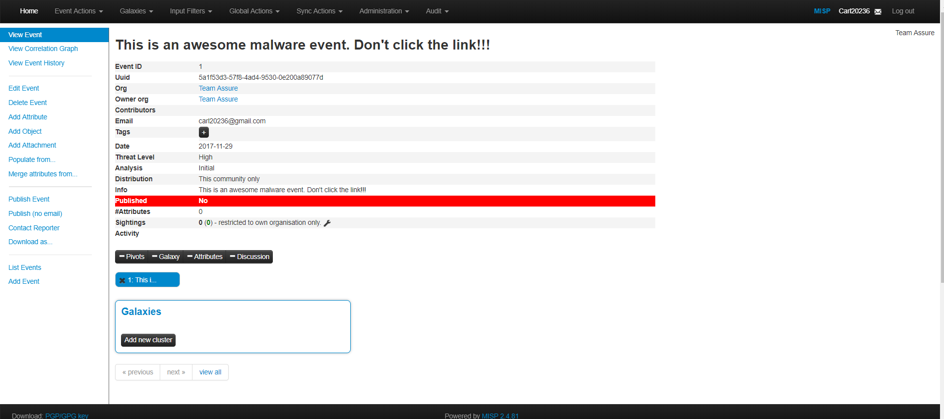
Event Information

Slide 4
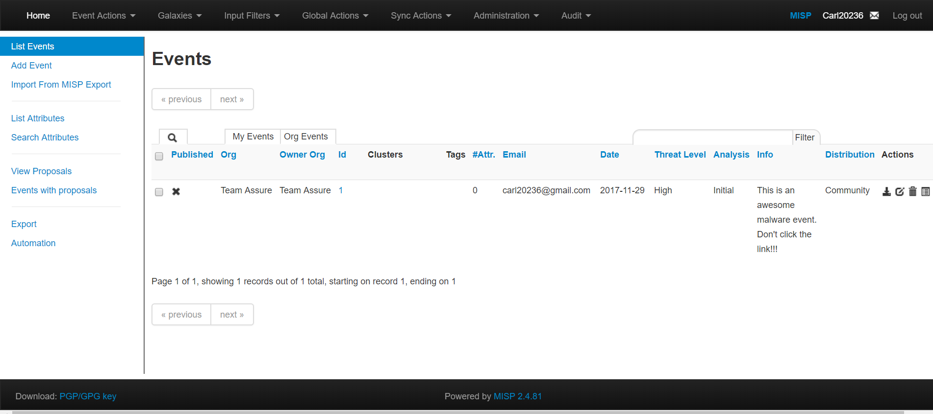
All Events

Slide 5
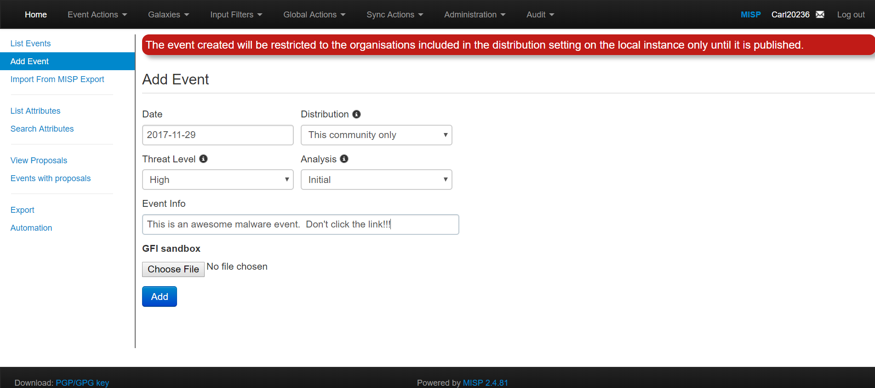
Add Event

Slide 6
Assurance Claims
The system's authentication mechanism is acceptably secure against common authentication attacks.
There are no exploitable Cross-Site Scripting weaknesses in the code.
Role based access is implemented in an acceptably secure manner

Slide 7
Assurance Claims Cont.
System prevents distribution of event information to those who are not permitted to view it.
The user management interface is acceptably secure.

Slide 8
Gaps in security requirements
Apache configuration
Firewall configuration
SMTP configuration

